Slide 1

Machine Learning and Sound
Stephen McLaughlin
PhD Student

Slide 2
Stephen McLaughlin / @SteveMcLaugh
Notes:
http://gtspirit.com/2014/03/12/renault-caterham-sports-car-design-as-good-as-finished/

Slide 3
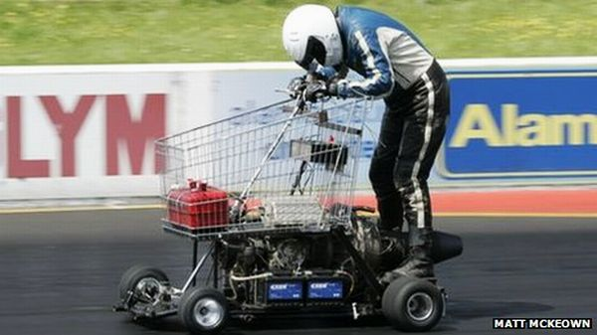
Stephen McLaughlin / @SteveMcLaugh
Notes:
https://www.youtube.com/watch?v=xz8_udPVdok
Fast, but not the easiest thing to handle — and it might be a bumpy ride

Slide 4
Stephen McLaughlin / @SteveMcLaugh
Notes:
This is not an option.

Slide 5
 | Feature 1 | Feature 2 | Feature 3 | Feature 4
Label A | 11.3166 | 13.1009 | 17.1638 | 1.2876
Label A | 0.0023 | 8.9224 | 7.3368 | 12.826
Label A | 13.9563 | 11.0516 | 8.5414 | 14.0572
Label A | 1.7851 | 9.1011 | 10.7928 | 4.5441
Label B | 12.0978 | 10.4598 | 5.7786 | 12.4596
Label B | 0.28 | 17.3005 | 3.7776 | 11.1616
Label B | 7.3366 | 13.3285 | 13.3285 | 17.5108
Label B | 7.1498 | 13.6181 | 13.391 | 7.3366
Label B | 10.9546 | 6.7191 | 13.0848 | 3.9394
Stephen McLaughlin / @SteveMcLaugh
Notes:
This is not an option.

Slide 6
Types of machine learning
Regression
output: a number
Classification
output: a class (i.e., category)
Stephen McLaughlin / @SteveMcLaugh
Notes:
#metadatagoals

Slide 7
Types of machine learning
Supervised learning
starting with labeled training data
Unsupervised learning
inferring relationships without class labels
Reinforcement learning
neural networks
Stephen McLaughlin / @SteveMcLaugh
Notes:
#metadatagoals

Slide 8
Disciplines in audio ML
Music information retrieval (MIR)
audio fingerprinting (Shazam)
automatic transcription
audio thumbnailing
Speech to text
Speaker recognition
speaker identification
speaker verification
Stephen McLaughlin / @SteveMcLaugh
Notes:
#metadatagoals

Slide 9

Stephen McLaughlin / @SteveMcLaugh
Notes:
This is not an option.

Slide 10
Model
Training set
Algorithm
Validation set
Test set
Real world
Stephen McLaughlin / @SteveMcLaugh
Notes:
#metadatagoals

Slide 11
Some key algorithms
Linear regression
numbers in, numbers out
Logistic regression
numbers and/or classes in, classes out
Stephen McLaughlin / @SteveMcLaugh
Notes:
#metadatagoals

Slide 12
Some key supervised learning algorithms
Linear regression
numbers in, numbers out
Logistic regression
numbers and/or classes in, classes out
Stephen McLaughlin / @SteveMcLaugh
Notes:
#metadatagoals

Slide 13
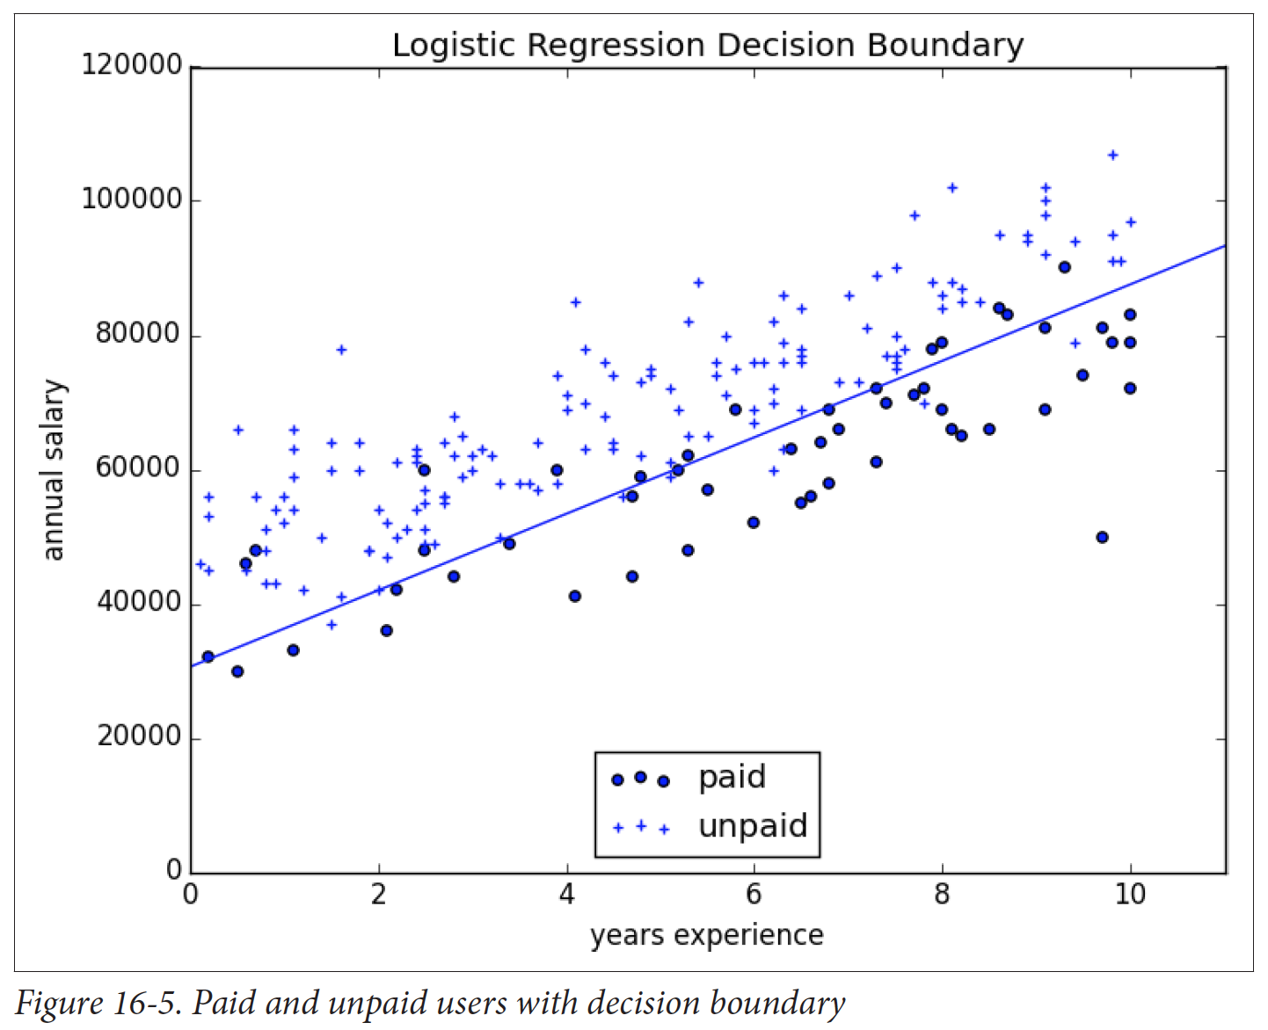
Logistic regression
prone to overfitting (training data not representative of real world)
Credit: Grus 2015
Stephen McLaughlin / @SteveMcLaugh
Notes:
Gradient boosting is a version of decision trees ... like they cut off the teee at some point?Both random forest and gradient boosting are optimization of decision trees

Slide 14
K nearest neighbor
the curse of dimensionality
intuitive, but not very efficient
Credit: Grus 2015
Stephen McLaughlin / @SteveMcLaugh
Notes:
#metadatagoals

Slide 15
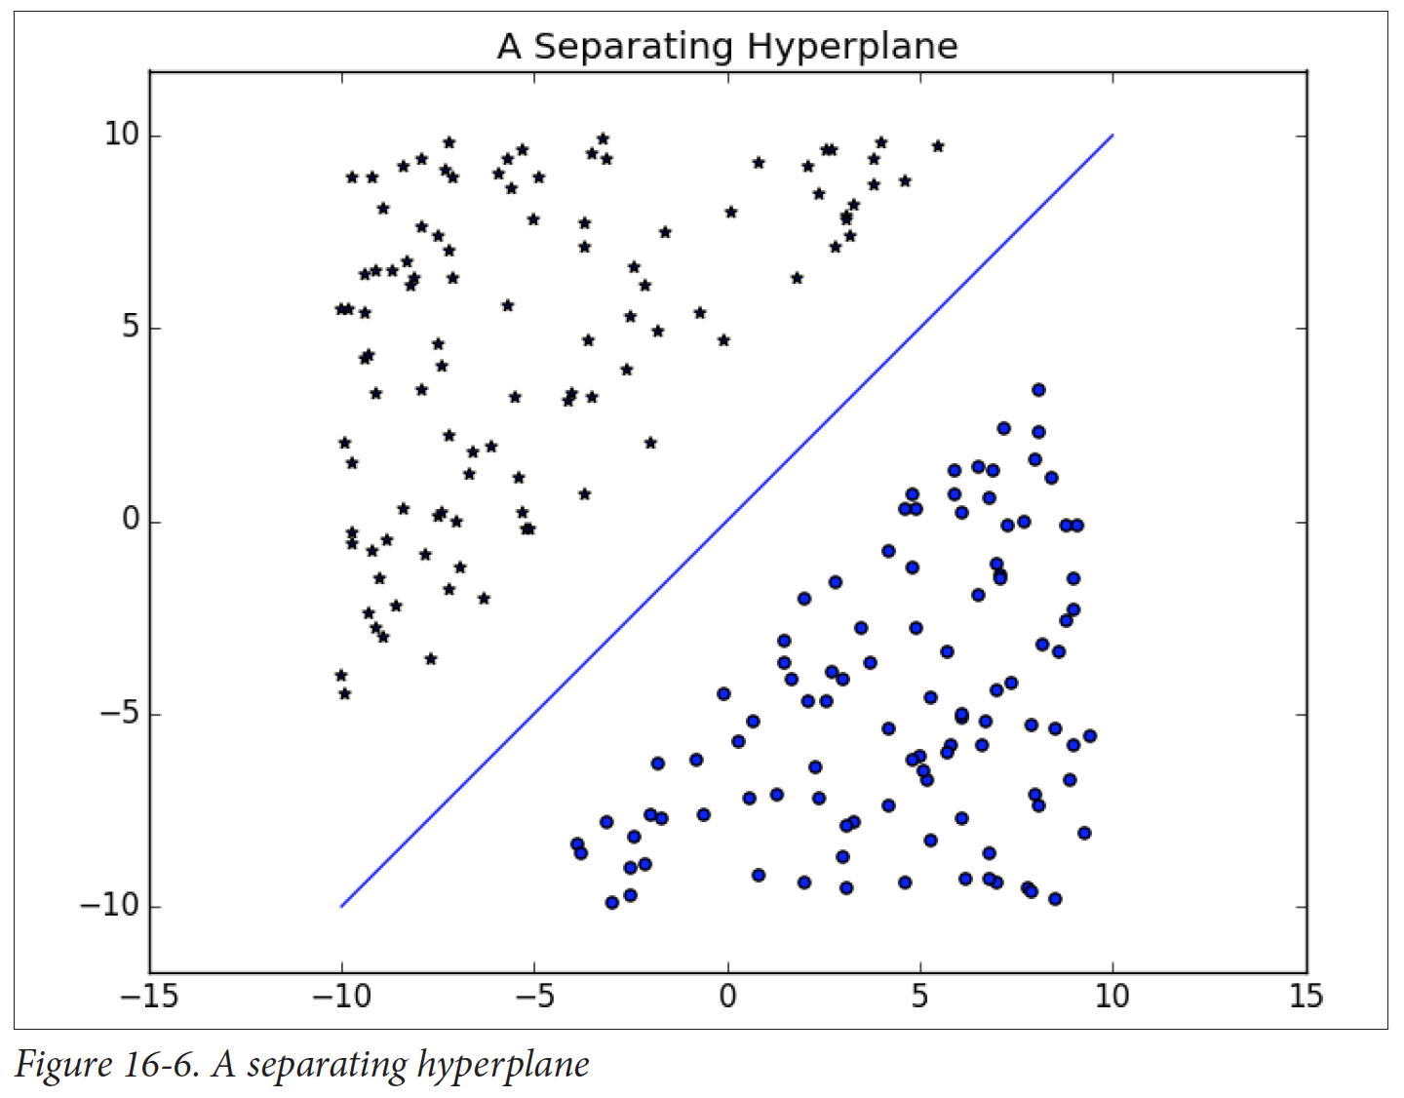
Support
vector
machine
(SVM)
Fast, cheap, and pretty good
Your #1 go-to
Credit: Grus 2015
Stephen McLaughlin / @SteveMcLaugh
Notes:
#metadatagoals

Slide 16
Decision
trees
Slower than SVMs
Highly interpretable results
Random forests and gradient boosting are improved variations
Credit: Grus 2015
Stephen McLaughlin / @SteveMcLaugh
Notes:
#metadatagoals

Slide 17
Gaussian
mixture
models
OK with shades of gray
Well-suited for speaker identification
Credit: Yu Zhu
Stephen McLaughlin / @SteveMcLaugh
Notes:
#metadatagoals

Slide 18
Neural networks
“The future”
Output not interpretable
Slow, expensive, steep learning curve
Credit: Wikimedia Commons
Stephen McLaughlin / @SteveMcLaugh
Notes:
#metadatagoals

Slide 19
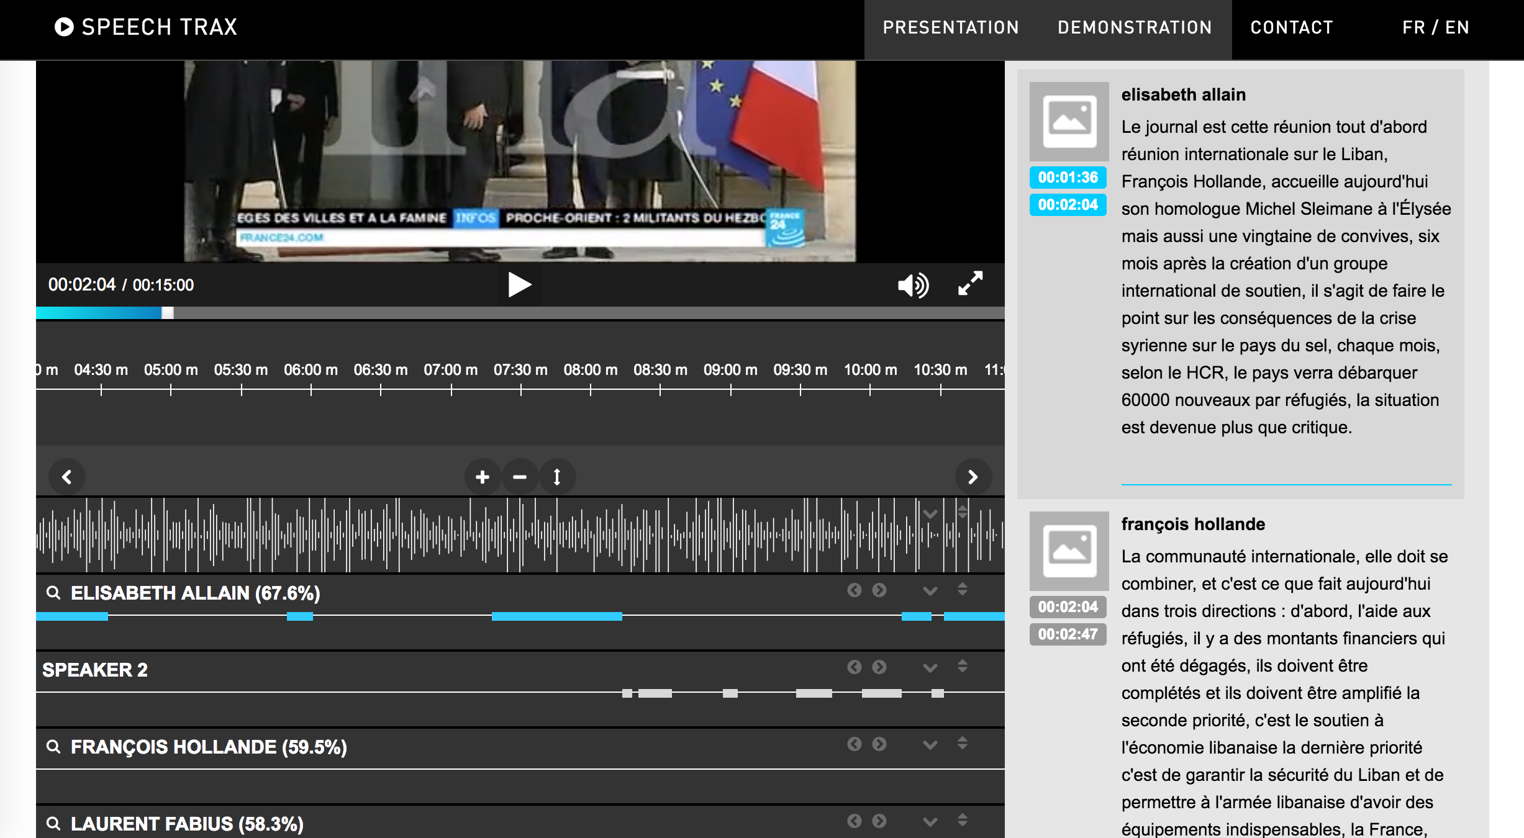
ML in archives
Stephen McLaughlin / @SteveMcLaugh

Slide 20
Bottlenecks to wide application
Stephen McLaughlin / @SteveMcLaugh

Slide 21
Bottlenecks to wide application
Compute time
Stephen McLaughlin / @SteveMcLaugh

Slide 22
Bottlenecks to wide application
Compute time
Existing metadata quality
Stephen McLaughlin / @SteveMcLaugh

Slide 23
Bottlenecks to wide application
Compute time
Existing metadata quality
Human ML training time
Stephen McLaughlin / @SteveMcLaugh

Slide 24
Bottlenecks to wide application
Compute time
Existing metadata quality
Human ML training time
Technical literacy
Stephen McLaughlin / @SteveMcLaugh

Slide 25
Bottlenecks to wide application
Compute time
Existing metadata quality
Human ML training time
Technical literacy
Copyright restrictions
Stephen McLaughlin / @SteveMcLaugh

Slide 26
Changes in the past 5 years
Processors are faster.
Storage is cheaper.
VPSes are friendlier.
More and better core ML tools.
More and better high-level wrappers.
GitHub and Stack Exchange are much larger.
Stephen McLaughlin / @SteveMcLaugh
Notes:
And I’m gonna be ... permit me to deal in straw men for a sec. This isn’t even polemical, it’s just a matter of fact.

Slide 27
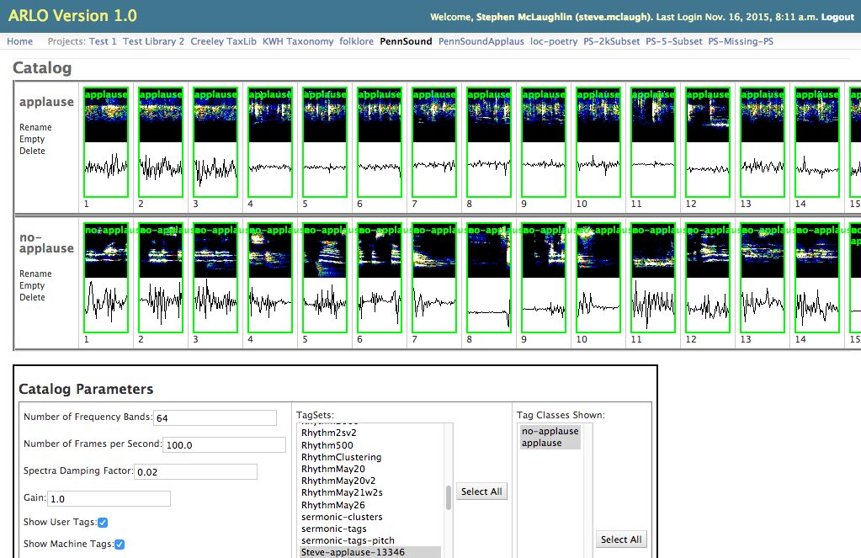
Stephen McLaughlin / @SteveMcLaugh
Notes:
Gradient boosting is a version of decision trees ... like they cut off the teee at some point?Both random forest and gradient boosting are optimization of decision trees

Slide 28
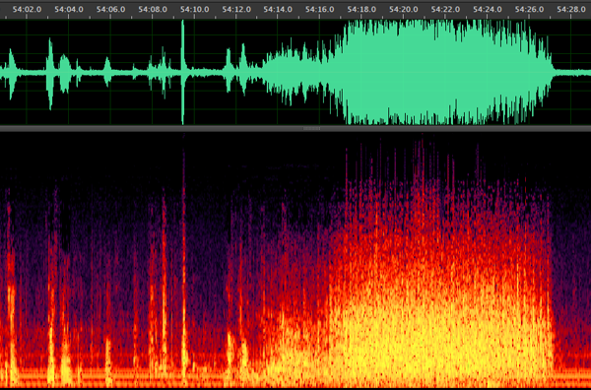
Reading by Charles Olson, Vancouver Poetry Conference, 1963
Stephen McLaughlin / @SteveMcLaugh

Slide 29
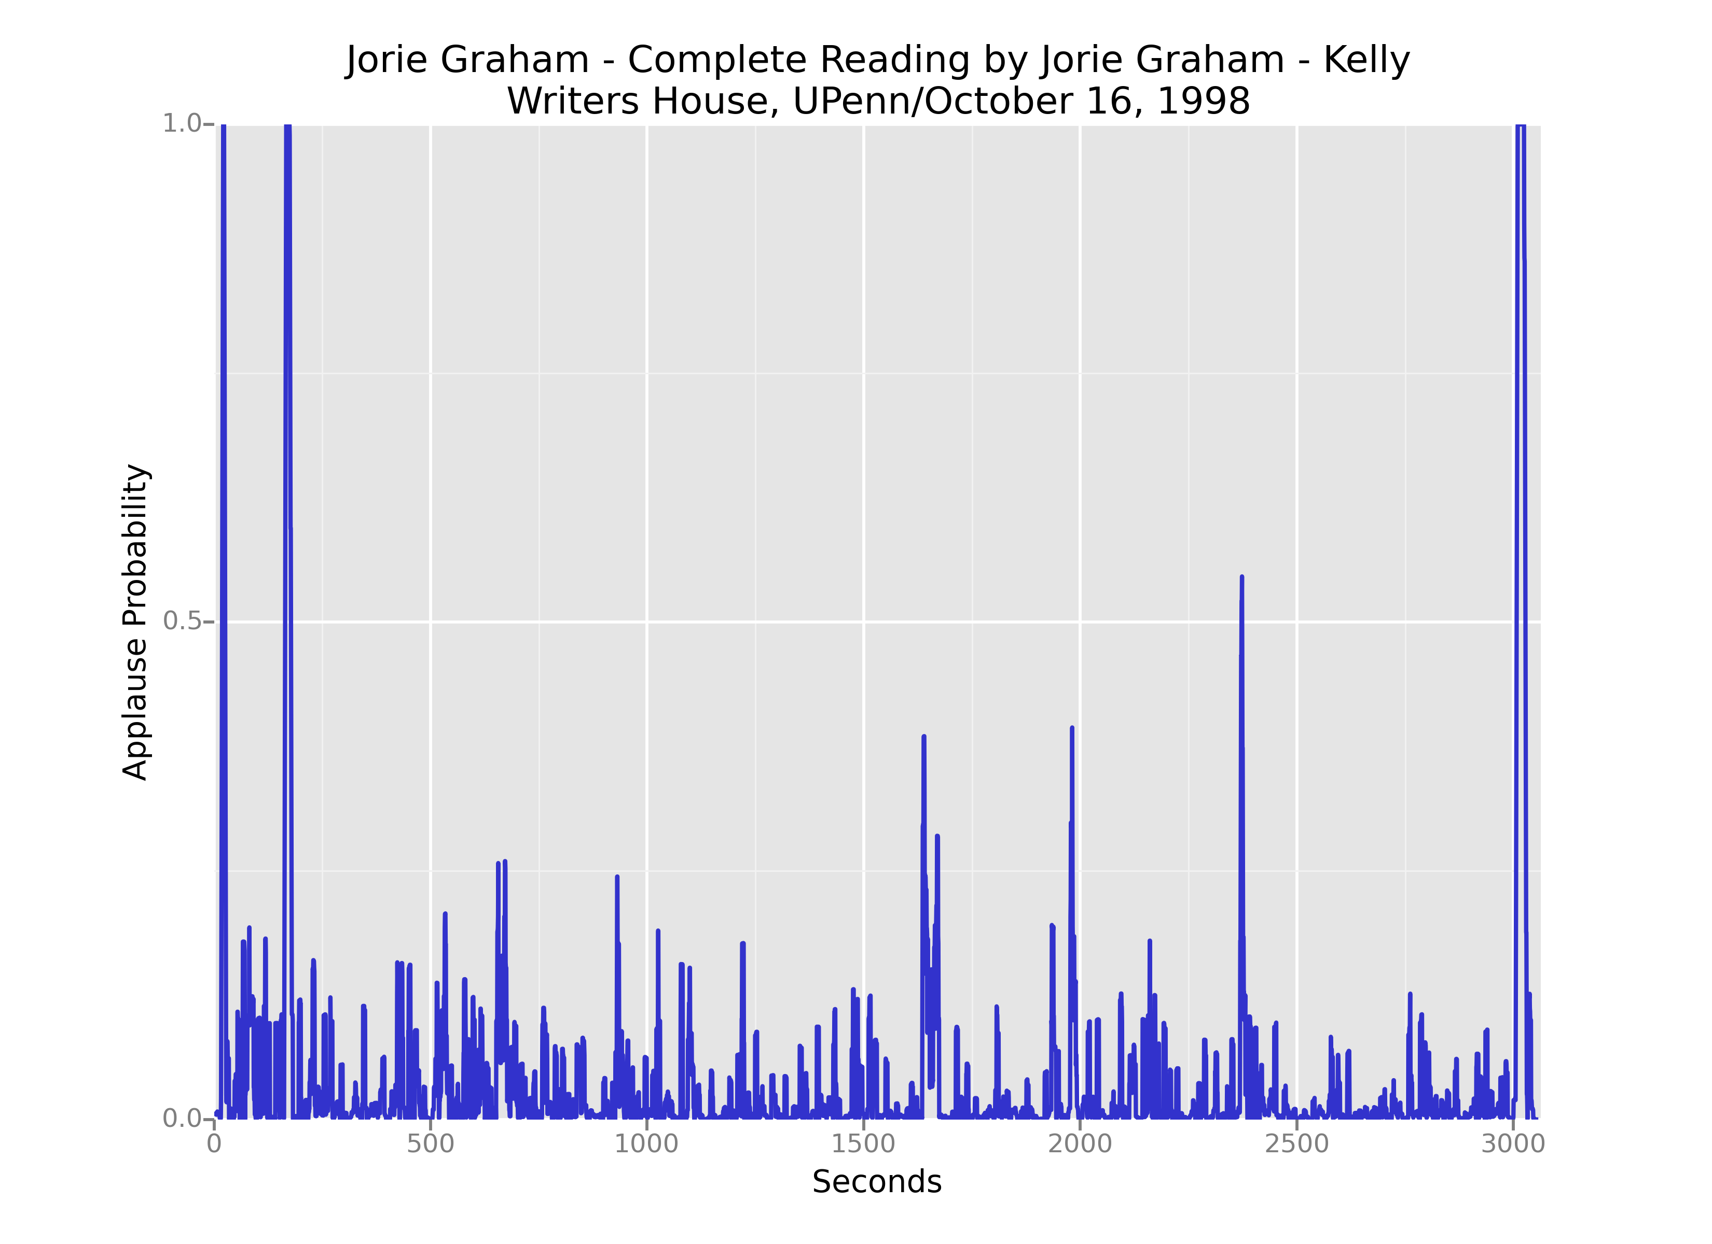
Stephen McLaughlin / @SteveMcLaugh
Notes:
SVM
"This is the idea behind the support vectormachine, which finds the hyperplane that maximizes the distance to the nearest pointin each class (Figure 16-6)."- data science from scratch

Slide 30
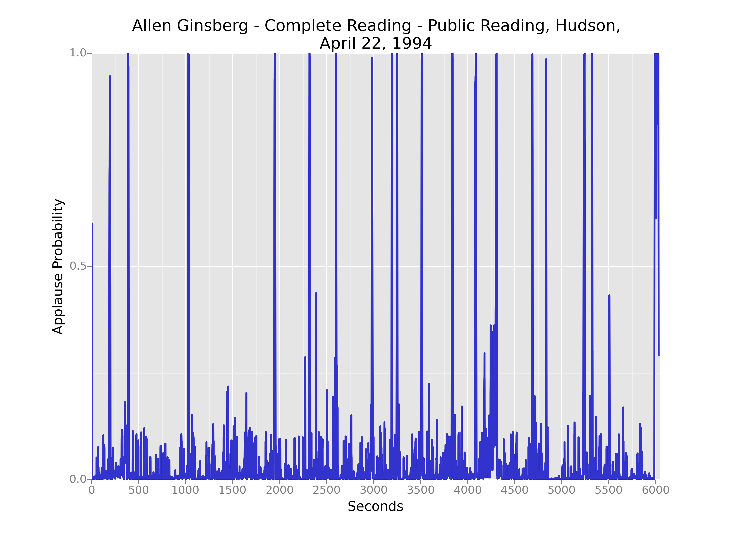
Stephen McLaughlin / @SteveMcLaugh
Notes:
Gradient boosting is a version of decision trees ... like they cut off the teee at some point?Both random forest and gradient boosting are optimization of decision trees

Slide 31
Stephen McLaughlin / @SteveMcLaugh
Notes:
SVM
"This is the idea behind the support vectormachine, which finds the hyperplane that maximizes the distance to the nearest pointin each class (Figure 16-6)."- data science from scratch

Slide 32
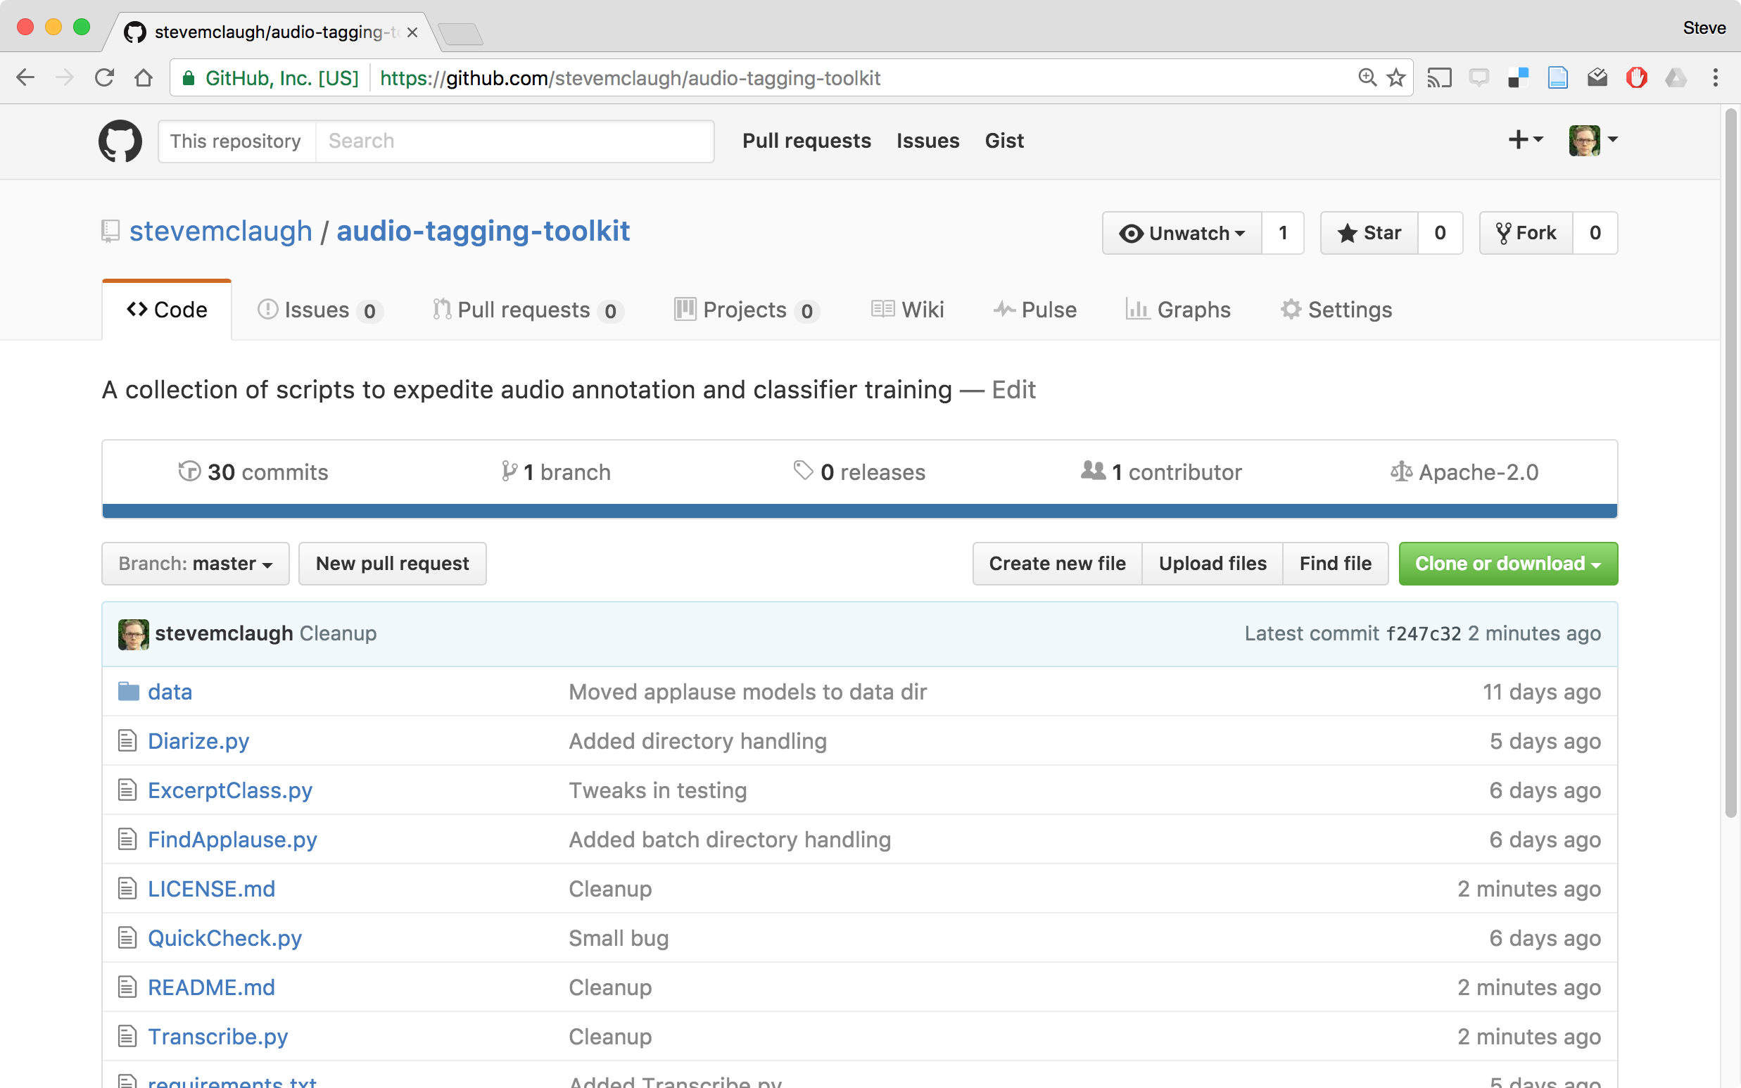
Stephen McLaughlin / @SteveMcLaugh
Notes:
REPLACE

Slide 33




PocketSphinx
Pyperclip
Stephen McLaughlin / @SteveMcLaugh

Slide 34
142.000000000,0,4.000000000,Applause
498.000000000,0,10.000000000,Applause
512.024761904,1,1406.000000000,Robert Creeley
1937.000000000,0,23.000000000,Applause
Sonic Visualiser
CSV file
Stephen McLaughlin / @SteveMcLaugh
Notes:
In the grand scheme, this is really refreshing. This is the whole session file — it has a hardcoded reference to the file’s pathname, totally transparent. But I take issue with the “frame” field ...
The sample rate is there, so one could check the timing later — but my real aim is to make this stuff friendly for humanists, who tend to be bad programmers — like me, by the way. I’m a bad programmer. I’m trying, but ... I’ll never be on the level of someone like Tony.
A lot of core GNU utilities have a –h option for human readability.
Be the -h you want to see in the world
PyDub handles this commendably: uses milliseconds regardless of sample rate

Slide 35
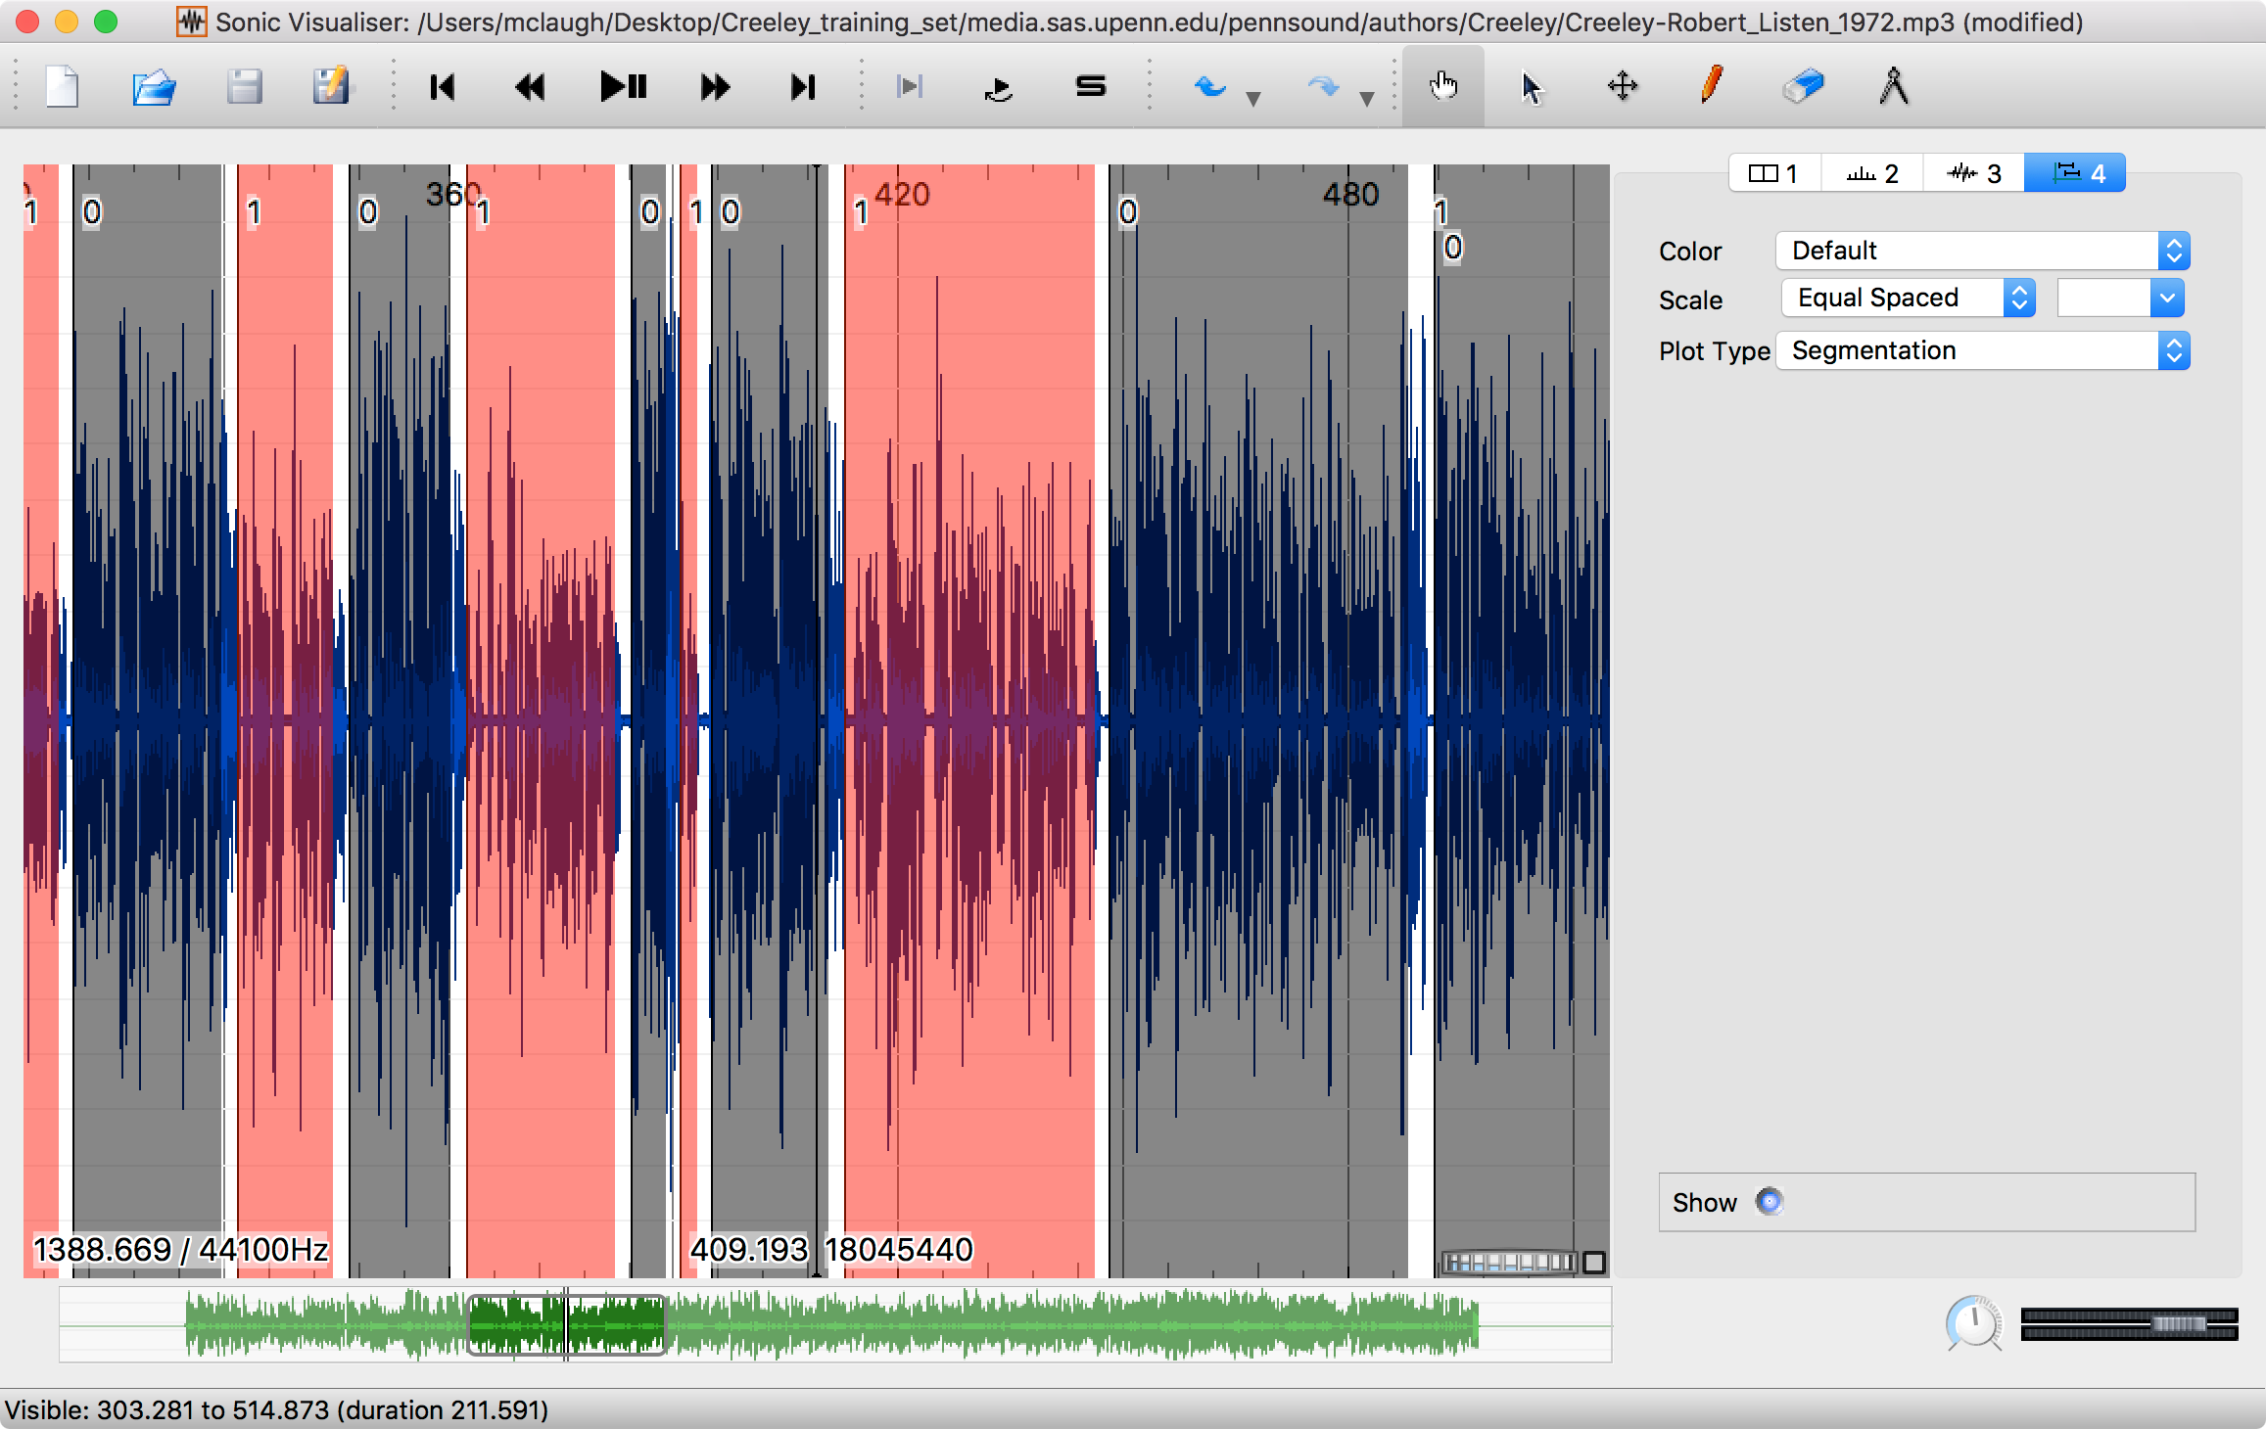
Stephen McLaughlin / @SteveMcLaugh

Slide 36
pyAudioAnalysis
Created and maintained by Theodoros Giannakopoulos
Built on scikit-learn and the SciPy stack
Executes training, classification, silence removal, etc.
Handles dimension reduction and hyperparameter tuning
Simple interface, comprehensible code from pyAudioAnalysis import audioTrainTest as aT aT.featureAndTrain(['Background','Creeley'], 1.0, 1.0, aT.shortTermWindow, aT.shortTermStep, "svm", "svm_creeley", False)
Stephen McLaughlin / @SteveMcLaugh
Notes:
*
If I was bitter or disillusioned about poetry culture, it was perhaps because I hadn’t found my own community.
But eventually I did.
In the years following Issue 1 I got involved in practice.
I submitted videos to Ubuweb.
I did archival work for PennSound and edited the podcast PoemTalk at the Writers House.
I hosted my own poetry interview podcast on Jacket2.org
And I hosted a reading series in Philadelphia from 2011 to 2014, called Principal Hand Presents.
The scene I was a part of — conceptual, post-conceptual — was essentially a complete gift economy.
Giving chapbooks away, sharing PDFs, swapping ideas and links on email threads.
- That became central to my understanding of what it was to write, to make things. Not an alternative to mass culture, but a parallel track where we had some autonomy.

Slide 37
Stephen McLaughlin / @SteveMcLaugh
Notes:
SVM
"This is the idea behind the support vectormachine, which finds the hyperplane that maximizes the distance to the nearest pointin each class (Figure 16-6)."- data science from scratch

Slide 38
Stephen McLaughlin / @SteveMcLaugh
Notes:
SVM
"This is the idea behind the support vectormachine, which finds the hyperplane that maximizes the distance to the nearest pointin each class (Figure 16-6)."- data science from scratch

Slide 39
General metadata goals
Segmentation by speaker
Segmentation by event structure
High-level labels
Language
Genre
Topic/theme
Low-level labels
Notable passages
Material features/quirks
Stephen McLaughlin / @SteveMcLaugh
Notes:
#metadatagoals

Slide 40
General search goals
Acoustic fingerprint search (à la Shazam)
Locate speaker of interest
Locate sound classes of interest
Full-text search
Stephen McLaughlin / @SteveMcLaugh
Notes:
The means to creating useful metadata as in the previous slide

Slide 41

⟶
applause detection and/or diarization
⟶
manual validation
⟶
speaker recognition
⟶
manual validation
⟶
annotated corpus
⟶
retrieval, segmentation, new ML training, etc.
Stephen McLaughlin / @SteveMcLaugh
Notes:
*
If I was bitter or disillusioned about poetry culture, it was perhaps because I hadn’t found my own community.
But eventually I did.
In the years following Issue 1 I got involved in practice.
I submitted videos to Ubuweb.
I did archival work for PennSound and edited the podcast PoemTalk at the Writers House.
I hosted my own poetry interview podcast on Jacket2.org
And I hosted a reading series in Philadelphia from 2011 to 2014, called Principal Hand Presents.
The scene I was a part of — conceptual, post-conceptual — was essentially a complete gift economy.
Giving chapbooks away, sharing PDFs, swapping ideas and links on email threads.
- That became central to my understanding of what it was to write, to make things. Not an alternative to mass culture, but a parallel track where we had some autonomy.

Slide 42
Stephen McLaughlin / @SteveMcLaugh
Notes:
This is not an option.

